Slide 1
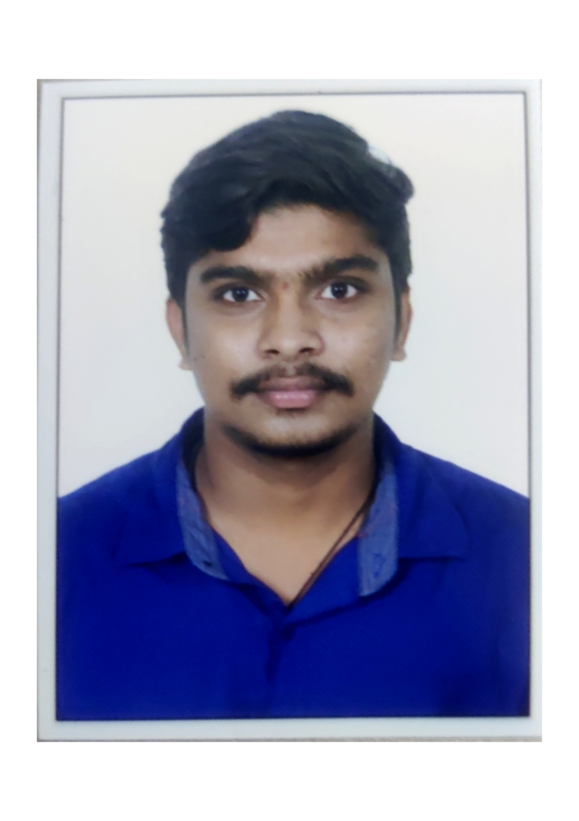


KOTA VEERA VENKATA MANIKANTA
Analyst/Software Engineer
BACHELOR OF TECHNOLOGY
Electronics and communication Engineering:2017-2021
Skills C#
Dot net core
C language
Manual testing
Advance Excel
DatabaseL
MS SQL Server 2019
SQL core
Web Technologies
HTML5
CSS3
AddOns
Github
Postman
Additional skills
Leadership Qualities
Quick Learner
Team Management
Good communication
BANGALORE
Veera-venkata.manikanta-kota@capgemini.com
+91 9182638531
A4
Well versed with the functional knowledge of SDLC stages ranging from Requirement Gathering to Analysis, Design, Development, Testing, Deployment and Documentation.
A team player with good communication skill always ready to work for the enrichment of knowledge. Able to adopt the process changes effectively.
Ability and flexibility to multi-task, prioritize, and organize multiple projects/ tasks concurrently while meeting project deadlines.
Have better understanding on process agility and can come to up to speed on new technologies/ methodologies in best possible way.
Able to deliver with zero defects products to customer with good development skills and interact with client with excellent communication skills.
Laundry Management System :
Completed end to end case study of Laundry management System along with postman, html, CSS.
Microsoft Azure Fundementals Certificate :
Completed this course with 80%.
Check out my work on GitHub & Video Profile

